Slide 1
AN EXPOSITION ON BABCOCK UNIVERSITY’S PROMOTION CRITERIA FOR ACADEMIC STAFF
By:
Dr. Seun Ebiesuwa
Lecturer, Computer Science Department, Babcock University

Slide 2
Presentation Outline
Assessment of Publications and other Productive Works
Thomson Reuter’s Impact Factor (Journal Impact Factor)
Journal Citation Reports (JCR) 2017 & Journal Impact Factor (JIF) 2017
Scimago Journal Rank (SJR)
Source Normalized Impact Per Paper (SNIP)
Scopus Database 2017
Scoring of Journal Articles

Slide 3
Presentation Outline (Contd.)
Academic Assessment of Books
Categorization of Books
Scoring of Major Articles, Minor Articles and Books
Percentage Distribution of Articles
Promotion Criteria Algorithm

Slide 4
Assessment of Publications and other Productive Works
Journal Article: This refers to a full-length article or paper published in a learned journal of good reputation.
Journal Categorization
Journals are categorized into three (3) as follows:
Category A
Category B
Category C

Slide 5
Assessment of Publications and other Productive Works (Contd.)
Category A: Peer-reviewed journals with either:
Thomson Reuter’s assigned impact factor, or
Scimago Journal Rank (SJR) or
Source Normalized Impact per Paper (SNIP)
any other acceptable ranking platform

Slide 6
Thomson Reuter’s Impact Factor (Journal Impact Factor)
JIF = citations in a year made to documents published in 2 previous
years
Number of citable items in 2 previous years
Hence, the JIF for a journal in 2010 will be computed as:
JIF = Number of citations received by a journal in 2010 to articles
published in 2008 and 2009
Number of citable articles published by the journal in
2008 and 2009
JIF only considers journals within the SSCI (Social Science Citation Index) and SCIE (Science Citation Index Expanded) databases

Slide 7
Where to find Journal Impact Factors
Journal Impact Factors are found in Journal Citation Reports (JCR).

Slide 8
Four Important Facts About Journal Impact Factor
1. Not all journals have impact factors. Journals must be indexed in Web of Science to have an impact factor.
2. A journal has only one impact factor, but it may be listed in more than one category
3. A journal impact factor should not be looked at in isolation, but in comparison to other journals in the same category
4. Impact factors vary across disciplines

Slide 9
Scenario 1
A researcher recently got his article published in the British Medical Journal (BMJ) which has an impact factor of 14.093
Question
Can the BMJ be rated as a good journal based on its impact factor?

Slide 10
Answer
To say that BMJ has an impact factor of 14.093 is not really meaningful, it is more useful to say that BMJ’s impact factor ranks sixth of 153 journals in the field of General and Internal Medicine or to compare its impact factor of 14.093 with the aggregate impact factor for its field (General and Internal Medicine): 3.919

Slide 11
Implication
It is therefore recommended that the impact factor of a journal should not be considered in isolation.

Slide 12
Relevance of Journal Impact Factor
Journal Impact Factor can help researchers:
1. identify good journals in which to publish
2. identify good journals relevant to their research interests
3. confirm the status of journals in which they have earlier published

Slide 13
Journal Citation Reports (JCR) 2017 & Journal Impact Factor (JIF) 2017
For JCR 2017 visit http://ipscience-help.thomsonreuters.com/incitesLiveJCR/8275-TRS.html
For JIF 2017 visit https://www.researchgate.net/publication/317604703_2017_Journal_Impact_Factor_JCR

Slide 14
Scimago Journal Rank (SJR)
SJR = average number of weighted citations received in a year
number of documents published in 3 previous years
Scimago uses a weighted citation score meaning that citations from a prestigious journal are scored more highly than those from a title that has a smaller citation network.
SJR only considers journals within the Scopus database.

Slide 15
Source Normalized Impact Per Paper (SNIP)
SNIP = journal’s citation count per paper
citation potential in its subject field
With SNIP, the impact of a single citation will have a higher value in subject areas where citations are less likely, and vice versa.
SNIP also like the SJR only considers journals within the Scopus database

Slide 16
Scopus Database 2017
For the list of Scopus indexed journals for 2017 visit https://www.researchgate.net/publication/316878648_Scopus_indexed_journal_list_2017

Slide 17
Assessment of Publications and other Productive Works (Contd.)
Category B:
International peer-reviewed journals not in Category A.
Journals published by Universities, Research Institutes, Learned Societies or Professional Bodies.
‘International’ here is not location-specific.

Slide 18
Assessment of Publications and other Productive Works (Contd.)
Category C: Other peer-reviewed journals not in categories A or B above.
Journals in this category must be acceptable to the Department/School

Slide 19
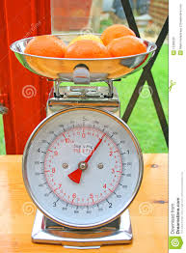
Scoring of Journal Articles
i. An applicant should be lead author in not less than 25% of joint authored publications
ii. There should not be more than 20% of presented articles in any one specific journal.
iii. There should not be more than two(2) articles in any single issue by the same author

Slide 20
Scoring of Journal Articles (Contd.)
iv. For the purpose of promotion to the grade of Senior Lecturer and above, not more than 10% of a candidate’s required publications should be in journals that have not gone beyond three (3) volumes, provided only one volume is published annually.

Slide 21
Scoring of Journal Articles (Contd.)
vi. Journals based in Colleges of Education and Monotechnics/Polytechnics are NOT acceptable for the purpose of promotion.
vii. Papers published online ahead of print (online early) in Category A and B journals shall be scored as published papers only if they have Digital Object Identifier (DOI) numbers.
viii. When a candidate publishes the same material more than once, only one shall be scored.

Slide 22
Scoring of Journal Articles (Contd.)
ix. Where there are more than one author, depending on the category of the journal, the first author shall score the maximum of the total score while the other authors shall score 2/3rd each of what the lead author gets

Slide 23
Scoring of Journal Articles (Contd.)
x. Each applicant should score not less than 70% in teaching and core values to be promoted
xi. Each applicant should score a minimum of 70% overall to be promoted

Slide 24
Required Percentage Distribution of Published Journal Articles for Assessment
Professor
A candidate applying for promotion to this rank should have a minimum of 10% of journal publications in Category A journals
The candidate should not have more than 40% of journal publications in Ranked/Indexed Journals
The candidate should not have more than 30% of journal publications in Society Journals
The candidate should not have more than 20% of journal publications in Institutional Journals

Slide 25
Required Percentage Distribution of Published Journal Articles for Assessment (Contd.)
Reader/Associate Professor
A candidate applying for promotion to this rank should have a minimum of 5% of journal publications in Category A papers
The candidate should not have more than 45% of journal publications in Ranked/Indexed Journals
The candidate should not have more than 30% of journal publications in Society Journals
The candidate should not have more than 20% of journal publications in Institutional Journals

Slide 26
Required Percentage Distribution of Published Journal Articles for Assessment (Contd.)
Senior Lecturer
A candidate applying for promotion to this rank should not have more than 40% of journal publications in Ranked/Indexed Journals
The candidate should not have more than 35% of journal publications in Society Journals
The candidate should not have more than 25% of journal publications in Institutional Journals

Slide 27
Required Percentage Distribution of Published Journal Articles for Assessment (Contd.)
Lecturer I
A candidate applying for promotion to this rank should not have more than 30% of his or her journal publications in Ranked/Indexed Journals
The candidate should not have more than 40% of his or her journal publications in Society Journals
The candidate should not have more than 30% of his or her journal publications in Institutional Journals

Slide 28
Required Percentage Distribution of Published Journal Articles for Assessment (Contd.)
Lecturer II
A candidate applying for promotion to this rank should not have more than 25% of his or her journal publications in Ranked/Indexed Journals
The candidate should not have more than 40% of his or her journal publications in Society Journals
The candidate should not have more than 35% of his or her journal publications in Institutional Journals

Slide 29
Academic Assessment of Books
A book is defined for the purpose of promotion/academic assessment, as a publication of:
more than 80 pages on 12 points or 100 pages on 14 points Times New Roman, single line-spaced, with cover excluded. A book must have an International Standard Book Number (ISBN).
ii. Book chapters must be assessed just like journal articles. All books to be considered must be published, not merely printed.

Slide 30
Categorization of Books
Books are grouped into four categories, namely:
(i) Category A:
Books written as the result of an original piece of work or research in the author’s field.
Must be published by a well-known academic publisher with evidence of peer review.

Slide 31
Categorization of Books (Contd.)
(ii) Category B:
Books written as a compilation of existing knowledge in an area in a new form.
Must be for Universities and other tertiary institutions.
Must be published by a well-known academic publisher with evidence of peer review.

Slide 32
Categorization of Books (Contd.)
(iii) Category C: This category includes books on creative work of art, plays, novels, collection of poems or books edited by the candidate in his/her discipline with evidence of peer review.
(iv) Category D: This is defined as a write-up lifted from other people’s work and paraphrased by the candidate
N.B: The Departmental/Faculty A&PC and not the internal assessor determines the categorization of books.

Slide 33
Scoring of Major Articles, Minor Articles and Books
For Journals, authors should earn:
0-2.5 points per article if it is MAJOR
0-1.5 points per article if it is MINOR
For Books, authors ought to earn:
0-2.5points for Category A
0-2 points for Category B
0-1.5 points for Category C
0 point for Category D

Slide 34
Table 1: General Assessment Criteria for Promotion of Academic Staff (Source: BU Promotion Criteria, 2017)
Criteria | Professor/University Librarian/Librarian | AP/Reader | Senior Lecturer/Librarian | Lecturer I/Librarian I | Lecturer II/Librarian II | Assistant Lecturer/Assistant Librarian
Qualifications | - | - | - | - | 5 (PhD) | -
Publications and creative works | 45 | 40 | 30 | 25 | 20 | 15
Teaching/professional experience | 25 | 25 | 24 | 21 | 18 | 15
Alignment with Core Values | 10 | 10 | 10 | 10 | 10 | 10
Community Service | 10 | 10 | 10 | 10 | 10 | 10
Leadership skills/traits | 7 | 7 | 7 | 5 | 4 | 4
Research Grant | 1 | 1 | 1 | 1 | 1 | 1
Local and International fellowship | 1 | 1 | 1 | 1 | 1 | 1
Conference/Learned Society Activities | 1 | 1 | 1 | 1 | 1 | 1
Total | 100 | 95 | 84 | 74 | 70 | 57

Slide 35
Table 2: Percentage Distribution of Publication of Journal Articles for Assessment (Source: BU Promotion Criteria, 2017)
 | Professor | AP/Reader | Senior Lecturer | Lecturer 1 | Lecturer 2 | Assistant Lecturer
Impact Factor | 10% | 5%
Ranked /Indexed Journals | 40% | 45% | 40% | 30% | 25%
Society Journals | 30% | 30% | 35% | 40% | 40%
Institutional Journals | 20% | 20% | 25% | 30% | 35%

Slide 36
Promotion Criteria Algorithm
Rank Applied for: Professor
Step 1: Start
Step 2: Be sure that at least 10% of candidate’s publications are in Category A journals
Step 3: Check if applicant is lead author in at least 25% of joint authored publications

Slide 37
Promotion Criteria Algorithm (Contd.)
Step 4: Ascertain that there is not more than 20% of candidate’s presented articles in any one specific journal. In the event that an applicant has more than 20% of presented articles in one specific journal, other papers in excess of the said 20% should not be scored.
Step 5: Ensure that not more than two(2) articles are published by the same author in any single issue of a journal. Any article beyond two in a single issue by the same author should be discountenanced.

Slide 38
Promotion Criteria Algorithm (Contd.)
Step 6: Be sure that not more than 10% of candidate’s required publications are in journals that have not gone beyond three (3) volumes, provided only one volume is published annually. Any other papers in excess of the said 10% shall not be scored.

Slide 39
Promotion Criteria Algorithm (Contd.)
Step 7: Check if any of the candidate’s required publications are in journals based either in Colleges of Education or Monotechnics/Polytechnics
Step 8: Ascertain that candidate’s papers published online ahead of print (online early) are either in Category A or B journals and that such papers have Digital Object Identifier (DOI) numbers.

Slide 40
Promotion Criteria Algorithm (Contd.)
Step 9: Ensure that for candidates who published the same material more than once, only one of such publications is scored.
Step 10: For joint authored publications, the candidate should be awarded the maximum score attainable on a paper in which he or she is the lead author while he or she should only be awarded 2/3rd of the maximum score attainable as co-author.

Slide 41
Promotion Criteria Algorithm (Contd.)
Step 11: Ascertain that the applicant scored a minimum of 70% of the maximum attainable points under “Teaching/professional experience”. For this rank, the minimum requirement is 17.5 of the maximum 25 points attainable for Teaching/professional experience.
Step 12: Check if the candidate scored up to 70% of the maximum attainable points under “Alignment with Core Values”. For this rank, the minimum requirement is 7 points of the maximum 10 points that can be accumulated for Alignment with Core Values.

Slide 42
Promotion Criteria Algorithm (Contd.)
Step 13: Ensure that the applicant scored a minimum of 70% of the total points that can be accumulated for promotion to the rank of a Professor.
Step 14: Stop

Slide 43
A Template of Faculty Evaluation Sheet

Slide 44
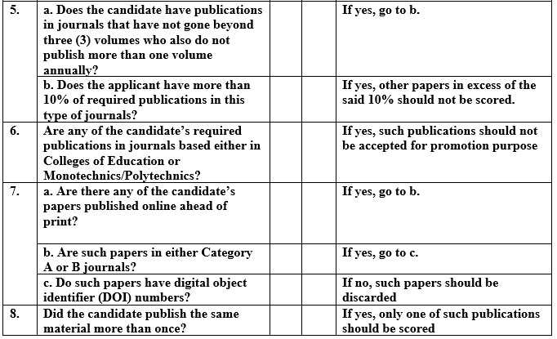
A Template of Faculty Evaluation Sheet (Contd.)

Slide 45
A Template of Faculty Evaluation Sheet (Contd.)

Slide 46
Scenario 2
Let us consider the following hypothetical example: Dr. Eunice Robinson is a female Associate Professor in BU with 38 publications. She has spent three (3) full years as an Associate Professor. She is applying for promotion to the rank of a Professor in the 2017/2018 promotion exercise. The faculty has:
twenty four (24) joint authored publications and fourteen (14) single authored papers.
twelve (12) joint authored publications in which she was lead author and twelve (12) papers which she co-authored

Slide 47
Scenario 2 (Contd.)
four (4) papers published in one specific journal.
not more than two (2) articles published in a single issue of any journal
no publication in any journal which has not gone beyond three (3) volumes.
none of her publications in journals based either in Colleges of Education or Monotechnics/Polytechnics

Slide 48
Scenario 2 (Contd.)
two (2) Category B papers with DOI numbers published online ahead of print
no publication of the same material made more than once
5 papers published in Category A journals with the candidate being the lead author in 3 and co-author in 2 of the 5 papers
22 papers in Category B journals with the candidate being the lead author in 12 and co-author in 10 of the 22 papers
11 papers in Category C journals with the candidate being the lead author in all 11 articles

Slide 49
Scenario 2 (Contd.)
Percentage of publications in Category A = 5 x 100 = 13.2%.
38
Percentage of joint authored publications with applicant as lead author= 12 x 100 = 50%
24
Percentage of publications in one specific journal = 4 x 100 = 10.5%
38

Slide 50
Scenario 2 (Contd.)
The points earned by this candidate for publications and creative works is computed as follow:
Category A
Lead authored articles = 2.5 x 3 = 7.5
Co-authored articles = (2/3 x 2.5) x 2 = 3.3
Sub-Total for Category A papers = 10.8
Category B
Lead authored articles = 2 x 12 = 24
Co-authored articles = (2/3 x 2) x 10 = 13.3
Sub-Total for Category B papers = 37.3

Slide 51
Scenario 2 (Contd.)
Category C
Lead authored articles = 1.5 x 11 = 16.5
Sub-Total for Category C papers = 16.5
Total points earned = Sub-Total for Category A papers + Sub-Total for Category B papers + Sub-Total for Category C papers = 10.8 + 37.3 + 16.5 = 64.6 out of the maximum attainable points of ((2.5 x 5) + (2 x 22) + (1.5 x 11) = 12.5 + 44 + 16.5 = 73)) that can be accumulated from the 5 Category A, 22 Category B and 11 Category C publications.

Slide 52
Scenario 2 (Contd.)
From Table 1,
The maximum points which a candidate being considered for promotion to the rank of Professor can earn under Publications and creative works is 45.
Hence, the score of 64.6 out of 73 earned by the candidate has to be converted to its equivalent on the scale of 45.
64.6 = x
73 45

Slide 53
Scenario 2 (Contd.)
By cross multiplication, we have:
x X 73 = 64.6 x 45
73x = 2907
x = 2907
73
x = 39.8
Hence, the candidate earned 39.8 out of the maximum 45 points attainable under publications and creative works for promotion to the rank of Professor.

Slide 54
Scenario 2 (Contd.)
Under teaching and professional experience, she had the following scores:
Length of Teaching – 8 points
Quality of Teaching/Students’ Assessment – 5 points
Computer Literacy – 4 points
Course Outlines – 4 points
Total points earned by the candidate for teaching and professional experience = 8 + 5 + 4 + 4 = 21 points

Slide 55
Scenario 2 (Contd.)
For the rank of a Professor, the maximum attainable points under teaching and professional experience is 25 points.
Score of the candidate expressed as a percentage of the maximum attainable points for teaching and professional experience = 21 x 100 = 84%
25
which is above 70% of the maximum attainable points under teaching/Professional experience for promotion to the rank of a Professor.

Slide 56
Scenario 2 (Contd.)
Under alignment with core values, she scored 8.5 of the maximum attainable 10 points.
Score of the candidate expressed as a percentage of the maximum attainable points for alignment with core values = 8.5 x 100 = 85%
10
which is above 70% of the maximum attainable points under alignment with core values for promotion to the rank of a Professor.

Slide 57
Scenario 2 (Contd.)
The candidate has the following scores against the respective criteria
Community Service - 7
Leadership skills/traits – 5
Research Grant – 1
Local and International fellowship – 1
Conference/Learned Society Activities – 1
Total points accumulated by candidate = 39.8 + 21 + 8.5 + 7 + 5 + 1 + 1 + 1 = 84.3 which is above 70% of the total points obtainable by a candidate applying for promotion to the rank of a Professor.

Slide 58
Scenario 2 (Contd.)
Percentage Distribution of Articles
Using the scenario just cited, the candidate had:
5 papers in Category A = 5 x 100 = 13.2%.
38
Hence, the candidate met the requirement of having at least 10% of her publications in Category A journals
22 papers made up of 10 ranked/indexed journals, 6 society journals and 6 institutional journals which all fall under Category B
10 ranked/indexed journals = 10 x 100 = 26.3%.
38
Thus, the candidate satisfied the requirement of having at most 40% of her publications in ranked/indexed journals.

Slide 59
Scenario 2 (Contd.)
6 society journals = 6 x 100 = 15.7%.
38
Hence, she satisfied the requirement of having at most 30% of her publications in society journals.
6 institutional journals = 6 x 100 = 15.7%.
38
Thus, she satisfied the requirement of having at most 20% of her publications in institutional journals.

Slide 60
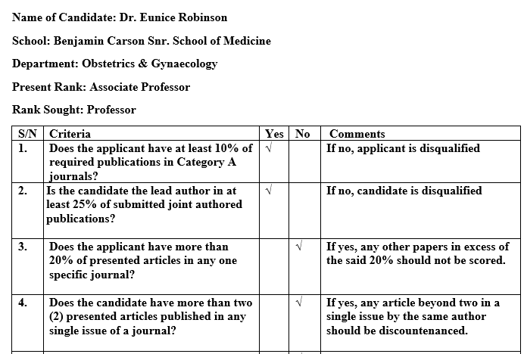
Evaluation Sheet for Faculty in Scenario 2

Slide 61
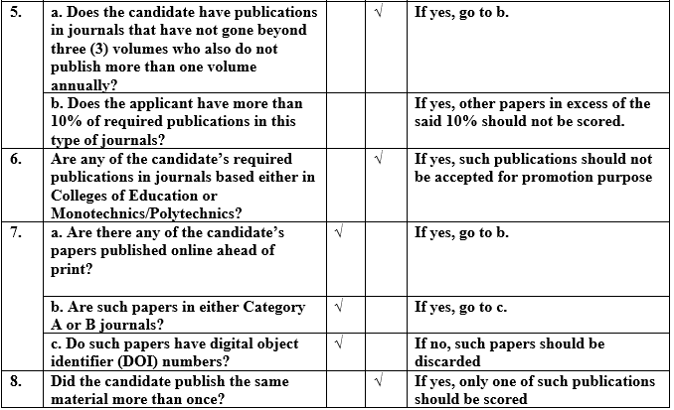
Evaluation Sheet for Faculty in Scenario 2 (Contd.)

Slide 62
Evaluation Sheet for Faculty in Scenario 2 (Contd.)

Slide 63
Portions of the Promotion Criteria Document that Require Revision
The phrase “any other acceptable ranking platform” under the definition of Category A journals may not be necessary since the document has already captured the three major ranking platforms.

Slide 64
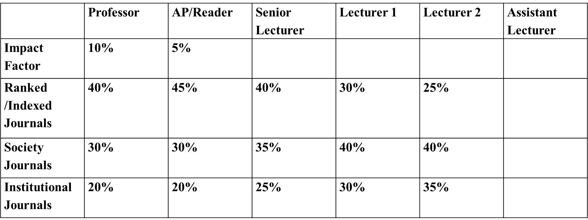
Table 2: Percentage Distribution of Publication of Journal Articles for Assessment (Source: BU Promotion Criteria, 2017)
2. The explanation to Table 2 as made during this presentation should be added to the promotion criteria document for the purpose of clarity

Slide 66
References
Babcock University (2017). Guidelines for the Assessment and Promotion of Academic Staff in Babcock University. Ilishan-Remo: Babcock University
Journal Citation Reports (2017). Retrieved November 2017, from Journal Citation Reports website: http://ipscience-help.thomsonreuters.com/incitesLiveJCR/8275-TRS.html
Journal Citation Reports (2017). Retrieved November 2017, from Journal Citation Reports website: https://www.researchgate.net/publication/317604703_2017_ Journal_Impact_Factor_JCR

Slide 67
References (Contd.)
Scopus (2017). Retrieved November 2017, from Scopus Indexed Journals website: https://www.researchgate.net/publication/316878648_Scopus_indexed_journal_list_2017

